Slide 1
DgdTool Developer’s PC Build Guide

Slide 2
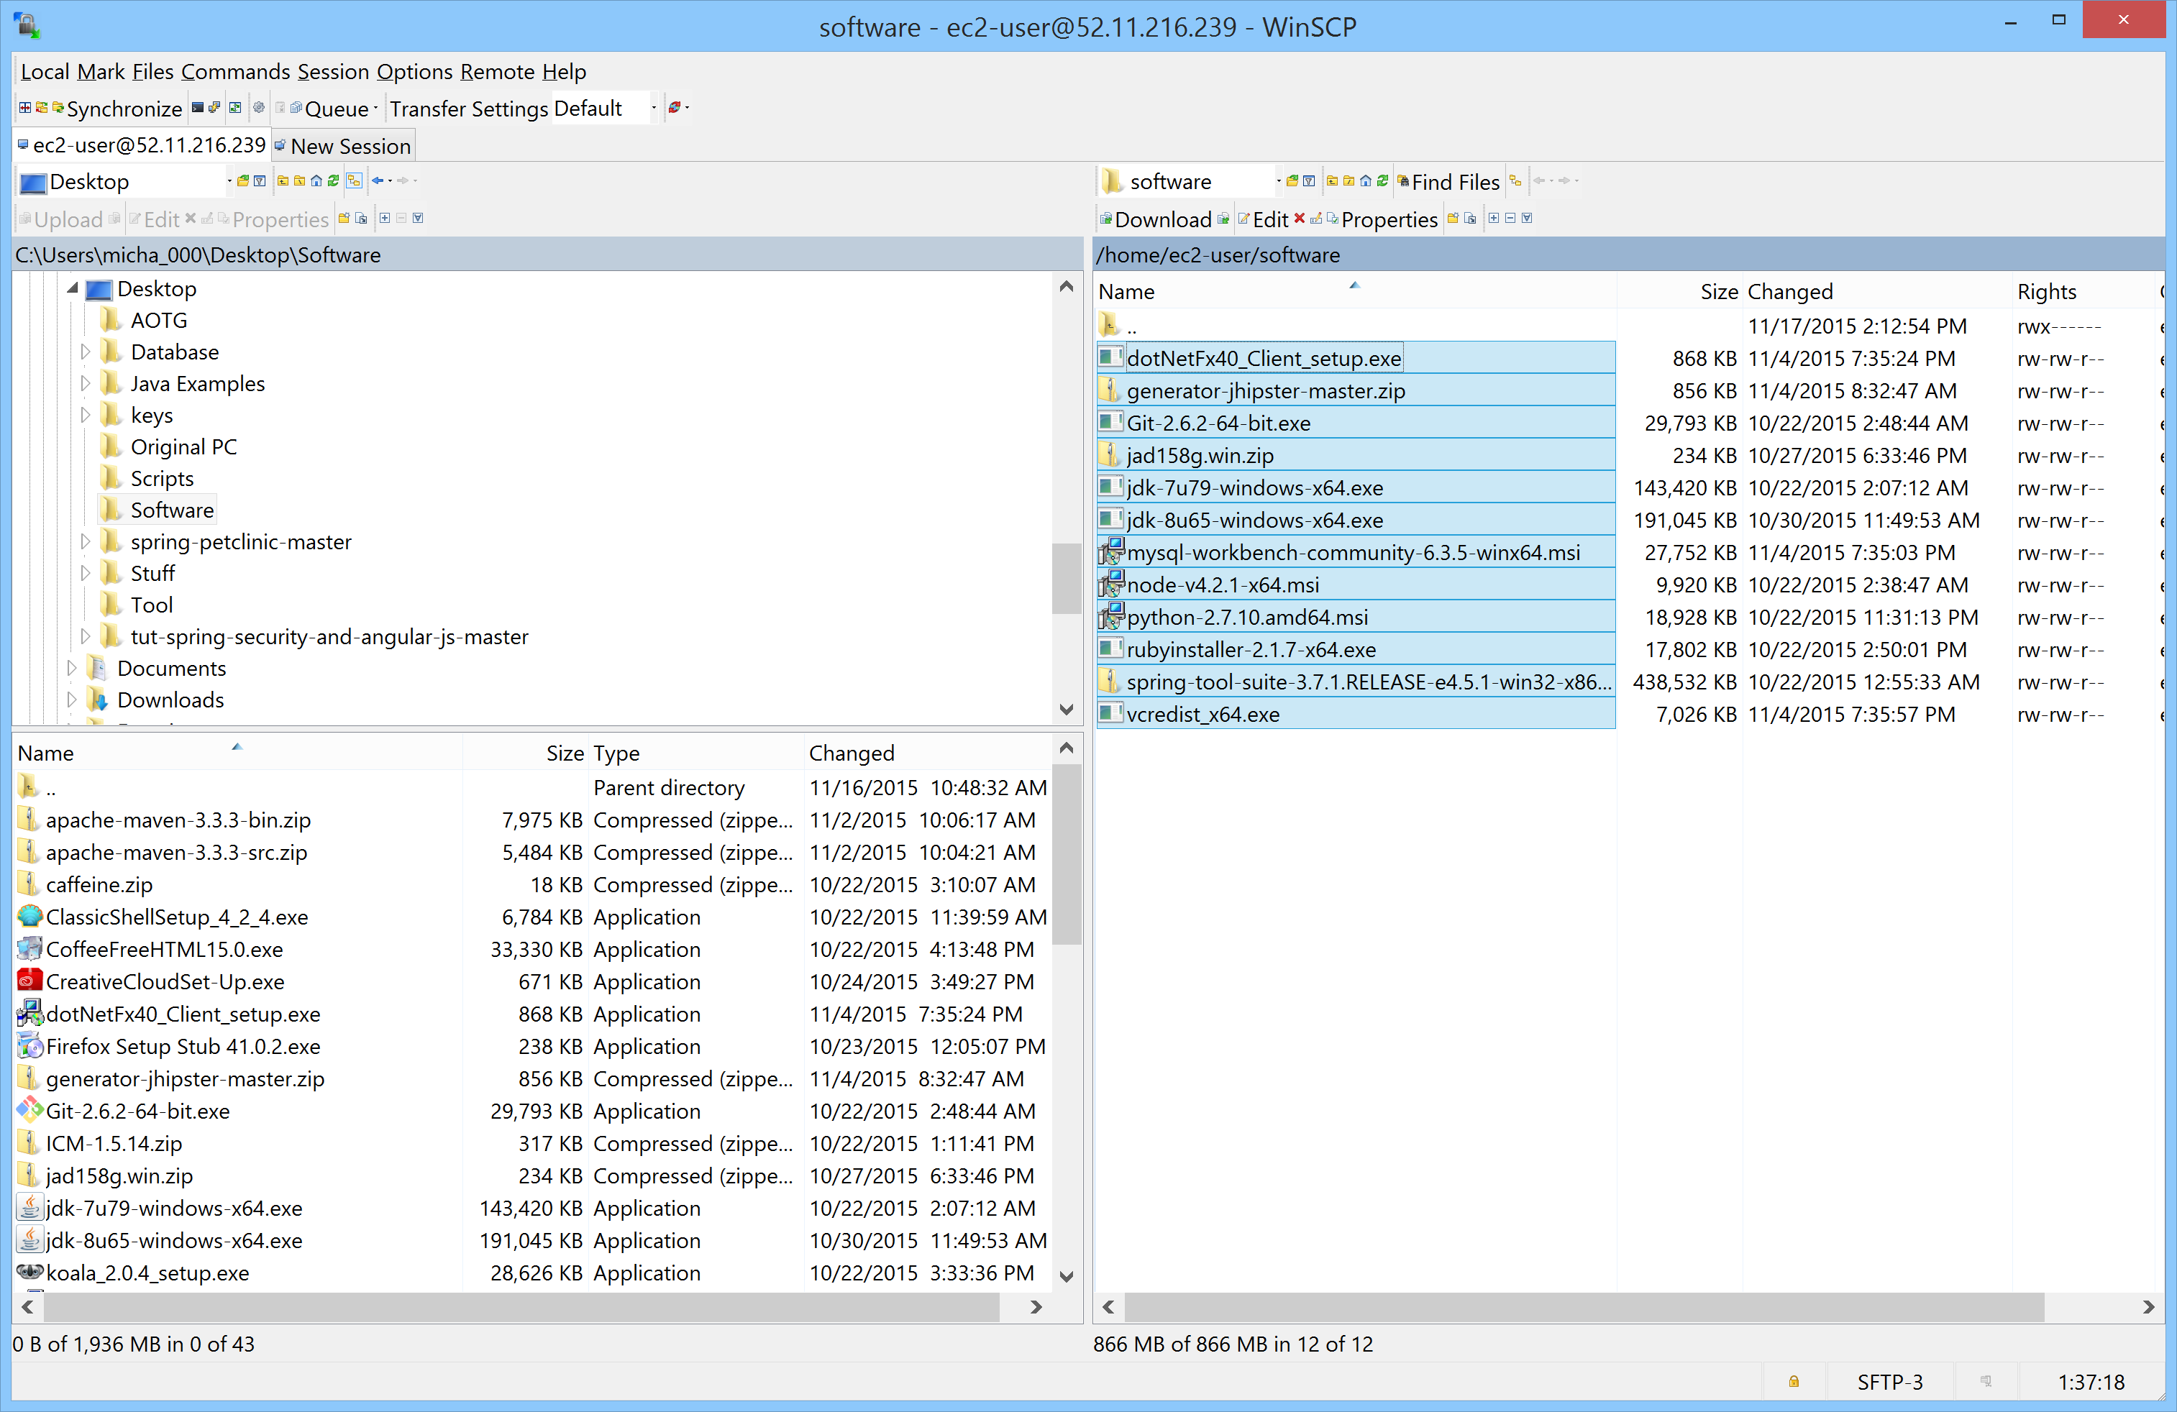
Download Putty.exe –
http://www.chiark.greenend.org.uk/~sgtatham/putty/download.html
Download and install WinSCP –
https://winscp.net/eng/download.php
Start a WinSCP session and connect to 52.11.216.239 using the ASP_TOOL.ppk file. Navigate to the /home/ec2-user/software directory. Then select/copy all of the files in that directory and drag/drop them into a local directory on your computer.

Slide 3
Run all of the installation programs in the following order
jdk-7u79-windows-x64.exe – just run executable
jdk-8u65-windows-x64.exe – just run executable
spring-tool-suite-3.7.1.RELEASE-e4.5.1-win32-x86_64.zip – extract zip contents to the directory you want to use i.e. c:\STS
mysql-workbench-community-6.3.5-winx64.msi – just run executable
python-2.7.10.amd64.msi – just run executable
node-v4.2.1-x64.msi – just run executable
rubyinstaller-2.1.7-x64.msi – just run executable
dotNetFx40_Client_setup.exe – just run executable
Git-2.6.2-64-bit.exe – just run executable
jad158g.win.zip – extract zip contents to the directory you want to use i.e. c:\jad
generator-jhipster-master.zip – extract zip contents to the directory you want to use i.e. c:\jhipster
Go to the Ruby home i.e. c:\ruby and execute the following command – gem install compass

